Slide 2
Patient Costs of Accessing Care at Health Facilities vs Community Based ART Delivery in Zimbabwe
Frank Chirowa, Nicoletta Ngorima-Mabhena, Owen
Mugurungi, Tsitsi Apollo, Blessing Ndidzano, Esther Tarowera, Geoffrey Fatti, Ashraf Grimwood, Lawrence Long, Brooke Nichols
Email frank.Chirowa@equiphealth.org/ frankchirowa@gmail.com
MPh( Global Health); Msc Economics

Slide 3
OUTLINE
BACKGROUND
METHODS
RESULTS
CONCLUSIONS
LIMITATIONS

Slide 4
BACKGROUND
Zimbabwe has an estimated 1,3 million people living with HIV and 84% on antiretroviral treatment (ART) in 2017. ¹
Distance, time to facilities, and travel costs are a significant barriers in accessing ART, particularly for those living in rural areas of sub-Saharan Africa.²
Community ART refill Groups (CARGs) are a strategy in Zimbabwe to reduce patient level barriers in accessing ART.³
However, limited literature on the effect of community versus health facility-based interventions to improve access to ART.⁴
Study Objective:
To determine patient-level benefits of implementing CARGs. An analysis of baseline stable patient costs when accessing care in CARGs vs Facility was conducted.
¹http://aidsinfo.unaids.org [Accessed 22/07/2018]
²Abongomera et al, 2018; Pose et al, 2008; Yehia et al, 2015
³Zimbabwe Operational Service Delivery Manual 2015
⁴Nachega et al, 2017
Notes:
CARGs; Stable patients based on VL will visit the facility after 12 months
Have 6-12 stable ART patients voluntarily forming a group
Choose a leader responsible for communication, data collection and linkage to the facility.
Meet at a community venue to receive ART refills
Have one group representative who goes and collects drugs from the facility.
Provide mutual support to each other

Slide 5
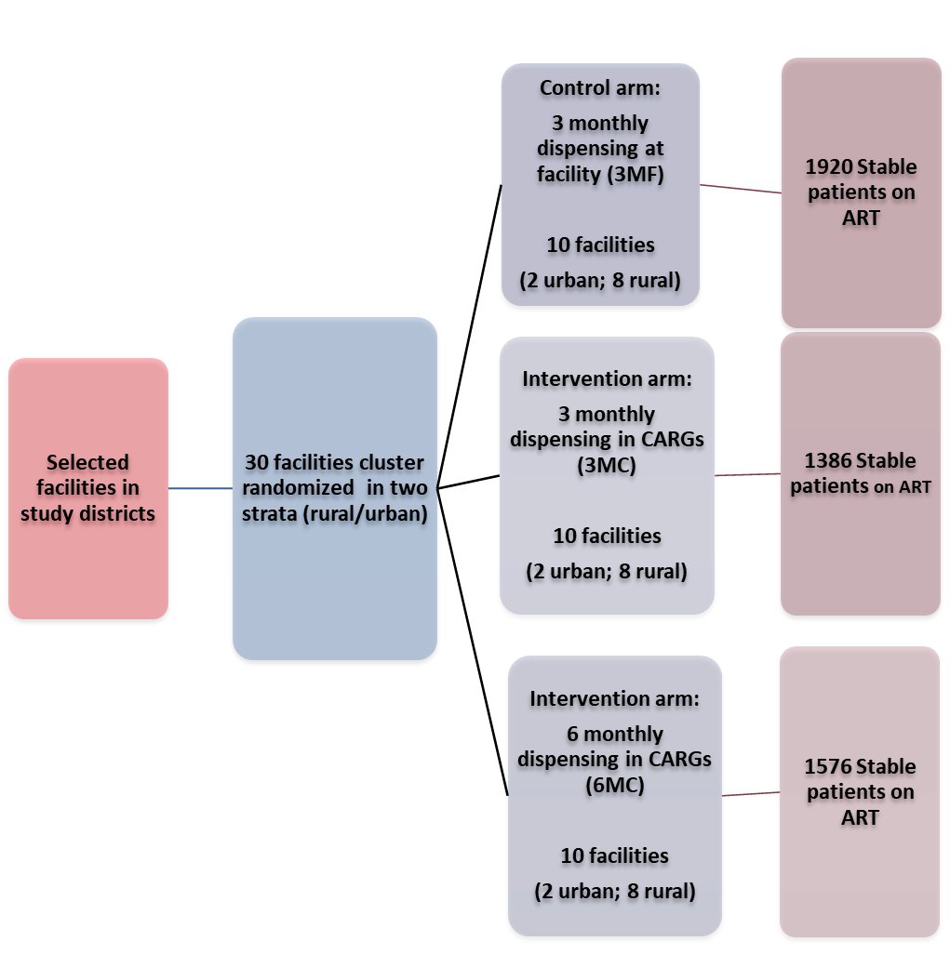
METHODS
Part of a pragmatic cluster-randomized trial to assess the effectiveness of differentiated models of ART delivery for stable ART patients in Zimbabwe (The MMSD Study). (ClinicalTrials.gov ID: NCT03238846) (Fatti et al; 2018)
Notes:
Study commenced in July 2017; Enrolment closed in Feb 2018
Original sample size-1920 per arm. Challenges in enrolling patients in the MC arms

Slide 6
METHODS (continued)
PROVINCES WHERE STUDY TOOK PLACE & HIV ADULT PREVALENCE
Four provinces & 5 districts (Chitungwiza, Gutu, Mberengwa, Beitbridge, Zaka) which are part of 22 USAID supported districts in Zimbabwe.
Baseline patient costing data collected at 30 study sites (July-Dec 2017)
Follow-up data collection to be repeated after 12 months (2018) and 24 months (2019)

Slide 7
SUB-ANALYSIS DESIGN & METHODS
Systematic random sampling: every 5th enrolled patient.
747 (79%) participants interviewed out of target sample size of 951.
Average distance, time and costs calculated.
Facility
N=331
Questions asked
Distance to facility
Transport costs to facility
Transport modes
Time taken to facility
Main study
N=4882
Period: Community patients were visiting facility
Period: Community Expectations
Community
( 3MC & 6MC)
N=416
Questions asked
Distance to facility
Transport costs to facility
Transport modes
Time taken to facility
Questions asked
Distance to CARGS
Transport costs to CARGS
Time taken to CARGS
Notes:
Calculated sample size 951. Did not reach calculated sample size as the study did not reach its 5760 calculated sample size

Slide 8
RESULTS: DISTANCE & TIME TAKEN TO FACILITY vs COMMUNITY
 | Clinics/Facility Arm | CARGS/ Community Arm | CARGS Expectations
Average distance (Km) travelled to the clinic by patients | 9km | 7 km | Distance to pick up place 0.9Km
TIME TAKEN TO GET TO THE FACILITY FOR A PICK-UP |  |  | EXPECTED TIME TO CUMMUNITY PICK UP PLACE
< 30 min | 0 | 0 | 285 (67%)
30min-1hr | 193 (58%) | 201 (48%) | 19 (5%)
1hr-2hrs | 75 (23%) | 98 (24%) | 4 (1%)
2hrs-3hrs | 61 (18%) | 96 (23%) | 1 (.2%)
>3hrs | 2 (1%) | 21 (5%)
Missing information | - | - | 107 (26%)
Total Respondents | 331 | 416 | 416

Slide 10
TRANSPORT COSTS TO THE FACILITY VS EXPECTED TRANSPORT COSTS TO THE COMMUNITY PICK-UP POINT
 | Clinics/Facility Arm | CARGS/Community Arm | CARGS Expectations
Transport cost to facility / CARGS (Two-way) | $3.78 95% CI (3.12-4.44) | $3.78 95% CI (2.56-5.02) | $1.80 95% CI (0.8-3.4)
52% expected reduction in transport cost by joining CARGS ($1.80 two-way vs $ 3.78 two-way at the facility)

Slide 11
Bus/Taxi : Rural 19% 95%CI (18%-22%); Urban 39% 95%CI (31%-47%)
Walking: Rural 76% 95%CI (73%-80%); Urban 58% 95%CI (50%-66%)
Notes:
Significant difference
Bus/Taxi : Rural 19% 95%CI (18%-22%); Urban 39% 95%CI (31%-47%)
Walking: Rural 76% 95%CI (73%-80%); Urban 58% 95%CI (50%-66%)

Slide 12
CONCLUSIONS
CARG members EXPECT :
Lower transport costs for ART refills in the community compared to the facility
To travel substantially shorter distances with reduced travel times to access care, compared to patients collecting ART from facilities.
CARGs are a differentiated model of care offering important benefits to stable ART patients as competing activities (farming, selling, school, gold panning) can still be done; one member collects medication on behalf of the group.
A comparison of the patient costing baseline data with actual 12 months and 24 months follow-up is critical to obtain actual patient benefits of implementing CARGs.

Slide 13
LIMITATIONS
The reported transport costs and distance to CARG meeting places are not actual but expected costs and distances as obtained from new CARG members.
Conclusion is based on baseline expected costs; actual costs will be obtained at 12 month and 24 month analysis.
Target sample size not reached.
Notes:
Introduction of bias as target sample size was not reached.

Slide 14
THANK YOU!!

Slide 15
REFERENCES
ABONGOMERA, E. 2018. Patient-level benefits associated with decentralisation of antiretroviral therapy services to primary health facilities in Malawi and Uganda.
APOLLO 2017. Effect of frequency of clinic visits and medication pick-up on antiretroviral treatment outcomes: a systematic literature review and meta-analysis. Journal of International Aids Society, 20.
EISINGER 2018. Ending the HIV/AIDS Pandemic. Emerging Infectious Diseases, 24, 413-416.
FATTI 2018. The effectiveness and cost-effectiveness of 3-vs.6-monthly dispensing of antiretroviral treatment (ART) for stable HIV patients in community ART refill groups in Zimbabwe: study protocol for a pragmatic, cluster-randomised trial. Trials, 19. https://trialsjournal.biomedcentral.com/articles/10.1186/s13063-018-2469-y
MOHCC 2017. Zimbabwe Operational Service Delivery Manual.
MYER 2017. Differentiated models of care for postpartum women on antiretroviral therapy in Cape Town, South Africa: a cohort study. Journal of International Aids Society, 20.
POSEETAL 2008. Barriers to accessing antiretroviral treatment in developing countries.
PRUST 2017. Multi-month prescriptions, fast-track refills, and community ART groups: results from a process evaluation in Malawi on using differentiated models of care to achieve national HIV treatment goals. Journal of International Aids Society, 20.
ROSEN 2007. Cost to patients of obtaining treatment for HIV/AIDS in SA. South African Medical Journal Sustained adherence and expanded access.
TULLER 2009. Transportation cost Impede Sustained Adherence and Access to HAART in a Clinic Population in South Western Uganda : A Qualitative Study.
ZDHS 2011. Zimbabwe Demographic Health Survey.
ZIMPHIA 2016. Zimbabwe Population Based HIV Impact Assessment.

Slide 16
Disclaimer
This presentation is made possible by the support of the American people through the United States Agency for International Development (USAID). The contents are the sole responsibility of Right to Care and do not necessarily reflect the views of USAID or the United States Government.

